Slide 1

Parallel & Distributed Computing Lecture Week 4 Amdahl’s Law
Farhad M. Riaz
Farhad.Muhammad@numl.edu.pk
Department of Computer Science
NUML, Islamabad

Slide 2







Amdahl’s Law
Theoretical speedup calculations
where
S_{latency} is the theoretical speedup of the execution of the whole task;
s is the speedup of the part of the task that benefits from improved system resources;
p is the proportion of execution time that the part benefiting from improved resources originally occupied.

Slide 3
Example 1
If 30% of the execution time may be the subject of a speedup, p will be 0.3; if the improvement makes the affected part twice as fast, s will be 2. Amdahl's law states that the overall speedup of applying the improvement will be?

Slide 4
Example 2
Assume that we are given a serial task which is split into four consecutive parts, whose percentages of execution time are p1 = 0.11, p2 = 0.18, p3 = 0.23, and p4 = 0.48 respectively. Then we are told that the 1st part is not sped up, so s1 = 1, while the 2nd part is sped up 5 times, so s2 = 5, the 3rd part is sped up 20 times, so s3 = 20, and the 4th part is sped up 1.6 times, so s4 = 1.6. By using Amdahl's law, the overall speedup is?

Slide 5
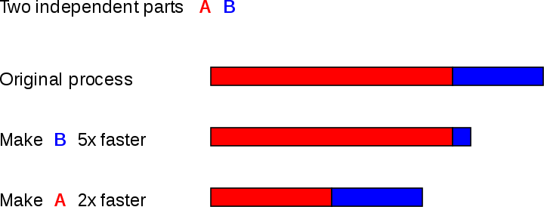
Amdahl’s Law

Slide 6
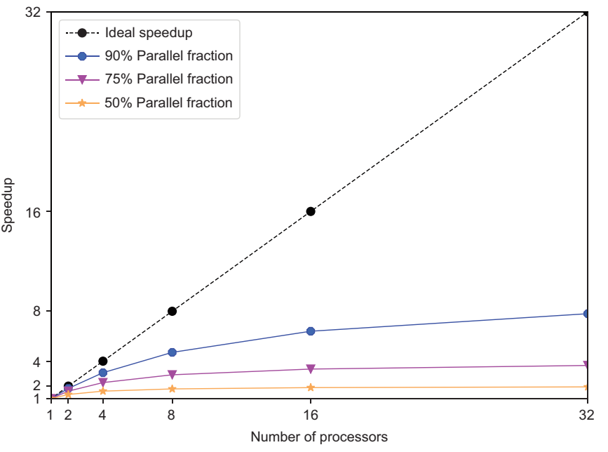

Slide 7
